Slide 1
Machine Learning
Decision Trees & Random Forests Notes

Slide 2
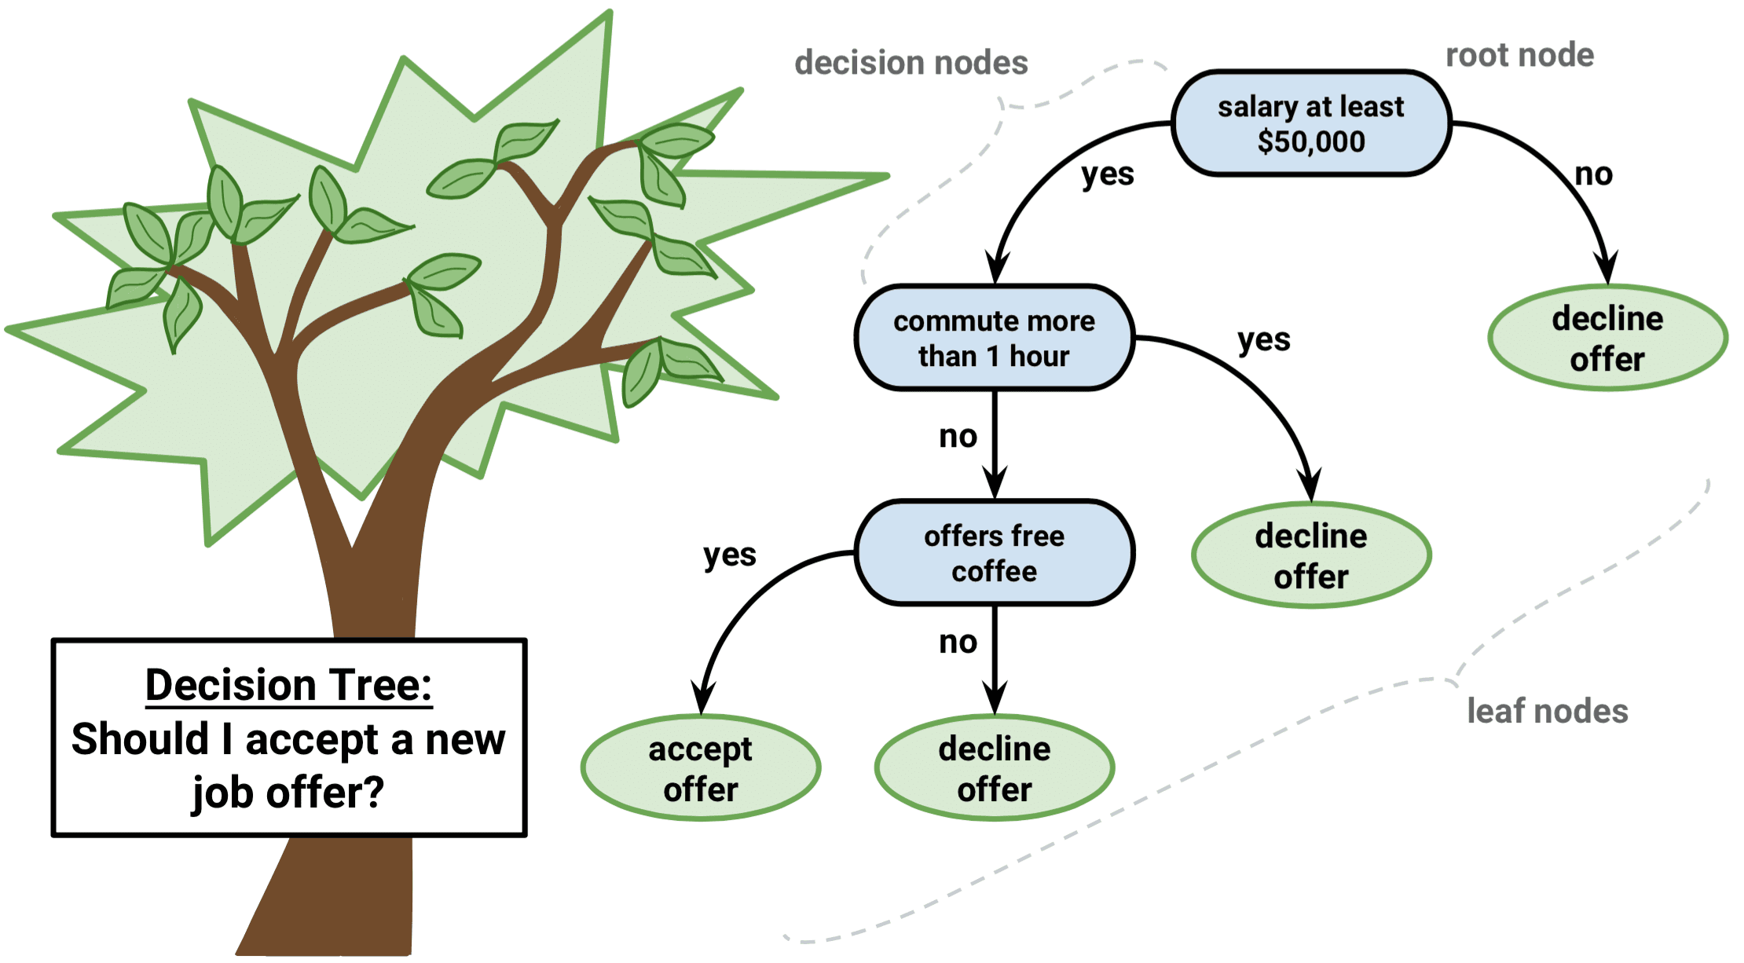
Decision Trees
Decision Trees (DT) are models in the form of a binary tree.
  In binary trees, each node is split into 2 nodes.
They are used to extract relationships (rules) between different variables and make decisions (classification/regression).
Alternatively, it can be represented as a set of rules: if-then.
Advantages:
  Work even with missing values (linear/logistic regression cannot work with missing values).
  Accept both numerical and categorical values.
  Interpretable models!
Applications: Medical Research, Finance, Business Modeling, Operation Analysis
Labels: Accept/Decline

Slide 3
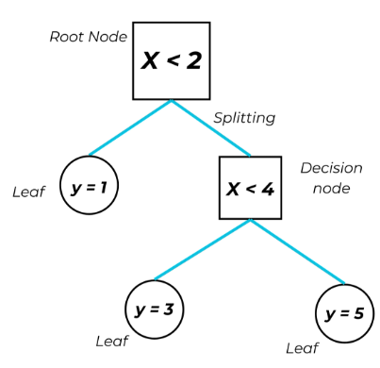
Decision Tree Structure
  Root: The root (initial) node of the tree. The most important node of the tree that determines how the dataset should split initially.
  Nodes: Represent the conditions (rules) that decide how the dataset will be split. The split is based on a selected feature.
    At each node, the tree tries to select the best possible feature.
    Each split results in the construction of sub-trees.
  Branch: The outcome of a rule which leads to another node.
    Each dataset split forms a new rule.
  Leaf: Represent the final decision of the tree.
Branch

Slide 4
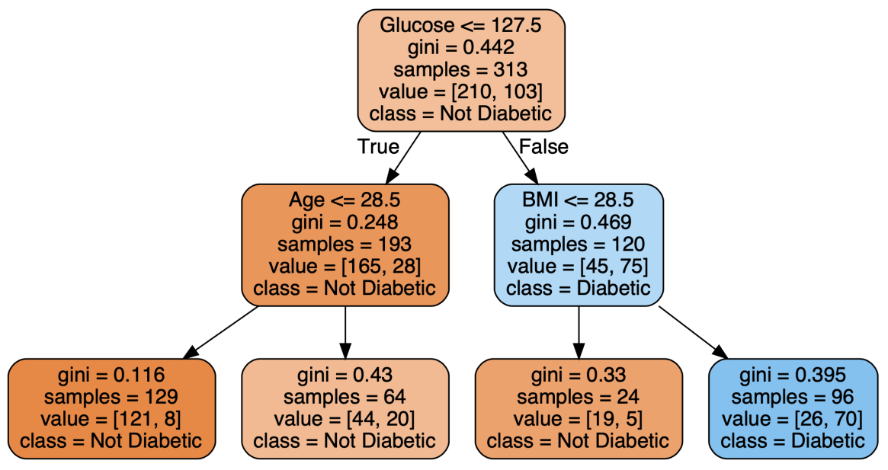
Decision Tree Example in Diabetes Dataset
root
If glucose <= 127.5 then LEFT else RIGHT
Node
Branch
If Age <= 28.5 then LEFT else RIGHT
If BMI <= 28.5 then LEFT else RIGHT
Leaf
Decision Tree of Depth 3 in diabetes classification task.

Slide 5
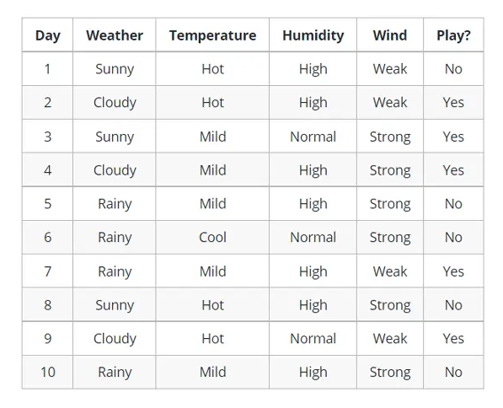
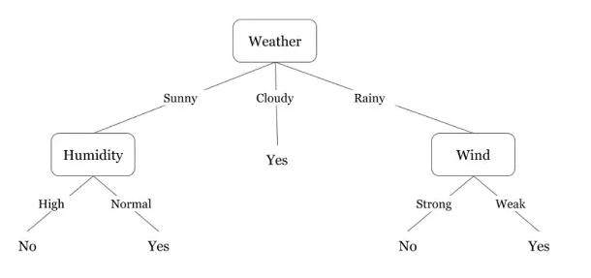
Dataset Splits
Each time a new branch is formed, a feature is selected, and the dataset is split. In this example, the dataset is split between sub-trees where Weather is Sunny and Weather is Rainy
sub-tree 1
sub-tree 2
Question: Which node should be selected as the root?

Slide 6
Tree Construction Process
The goal at each node is to select a variable, which will result in splits (sub-trees) that are more certain about the outcome.
Metrics (Criterions) that measure certainty:
  Gini Impurity
  Entropy
  Information Gain
Selecting the Best Attribute: This metric is calculated for each variable and decides which variable is the best for a specific node.
Splitting the Dataset: The dataset is split into subsets based on the selected variable.
Repeating the Process: The process is repeated recursively for each subset until a stopping criterion is met (e.g., all instances in a node belong to the same class or a predefined depth is reached).

Slide 7
Tree Construction Methods
Brute-Force: Tries all possible combinations. No metric “certainty” metric is involved here.
  Impossible for large datasets.
ID3: Splits each node using Information Gain as criterion. The idea is to split the node is such a way that minimizes the Entropy (or oppositely, maximizing the Information Gain). Low entropy (high Information Gain) at each node indicates that the tree is more certain for its decisions.
C4.5: Extension of ID3, supports numerical values, missing values and applies branch pruning to prevent overfitting.
CART: Similar to C4.5, but utilizes binary trees only.
  Classification Criterion:
      Gini
      Cross-Entropy
  Regression Criterion:
      MSE

Slide 8
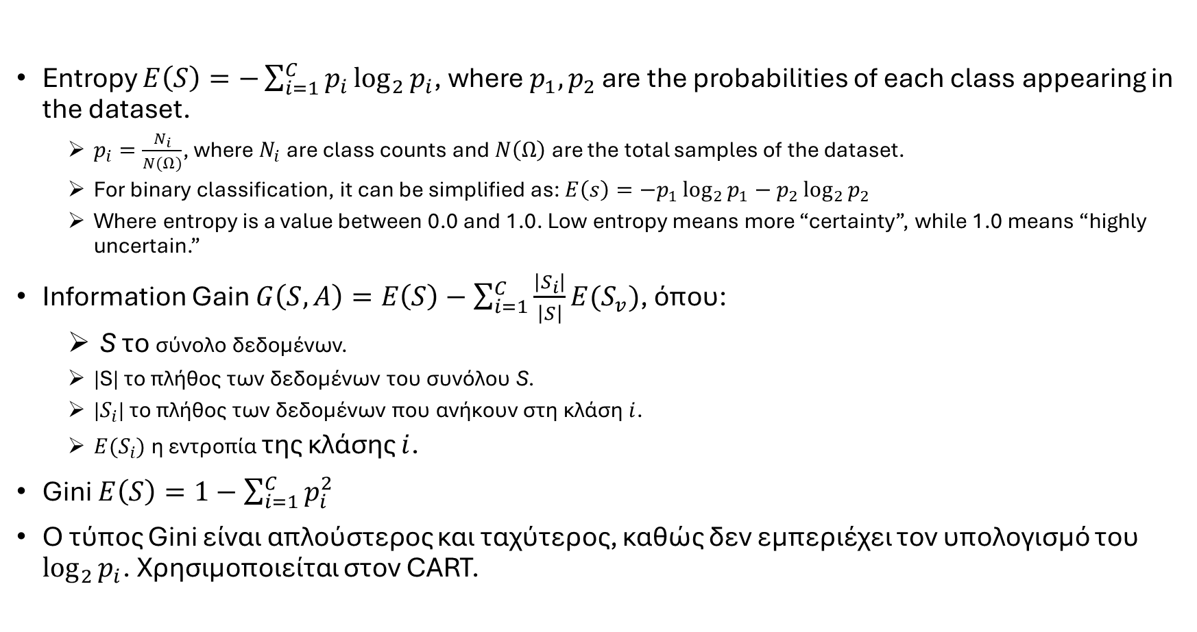
Splitting Criterions
Entropy $E\left(S\right)=−\sum_{i=1}^{C}{p_{i}\log_{2}{p_{i}}}$, where $p_{1},p_{2}$ are the probabilities of each class appearing in the dataset.
  $p_{i}=\frac{N_{i}}{N(Ω)}$, where $N_{i}$ are class counts and $N\left(Ω\right)$ are the total samples of the dataset.
  For binary classification, it can be simplified as: $E\left(s\right)=−p_{1}\log_{2}{p_{1}}−p_{2}\log_{2}{p_{2}}$
  Where entropy is a value between 0.0 and 1.0. Low entropy means more “certainty”, while 1.0 means “highly uncertain.”
Information Gain $G\left(S,A\right)=E\left(S\right)−\sum_{i=1}^{C}{\frac{\left|S_{i}\right|}{\left|S\right|}E(S_{v})}$, όπου:
  S το σύνολο δεδομένων.
  |S| το πλήθος των δεδομένων του συνόλου S.
  |$S_{i}$| το πλήθος των δεδομένων που ανήκουν στη κλάση $i$.
  $E(S_{i})$ η εντροπία της κλάσης $i$.
Gini $E\left(S\right)=1−\sum_{i=1}^{C}{p_{i}^{2}}$
Ο τύπος Gini είναι απλούστερος και ταχύτερος, καθώς δεν εμπεριέχει τον υπολογισμό του $\log_{2}{p_{i}}$. Χρησιμοποιείται στον CART.

Slide 9
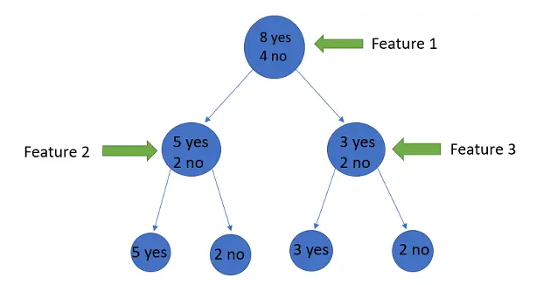
Entropy Example
If entropy is utilized, feature 2 or feature 3 predicts better the class of a sample?

Slide 10
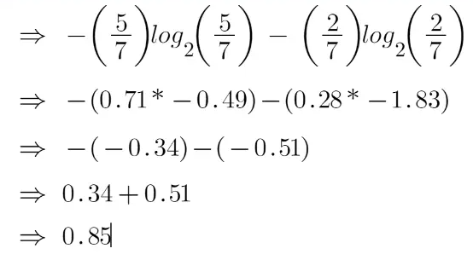
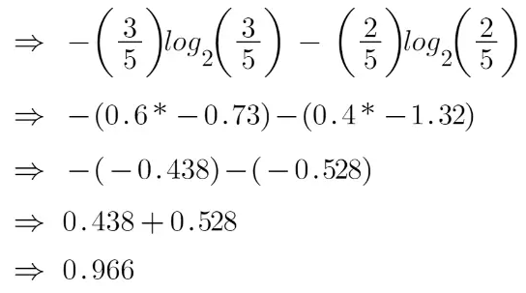
Example Solution
For feature 2:
For feature 3:
Conclusion: feature 2 minimizes Entropy, so it’s more important than feature 3.
This is because Feature 2 has more samples that belong to “yes” class, making the
tree more certain that if a sample goes left, it is probably a yes. On the other hand,
feature 3 has almost 50-50 probability for each class.

Slide 11
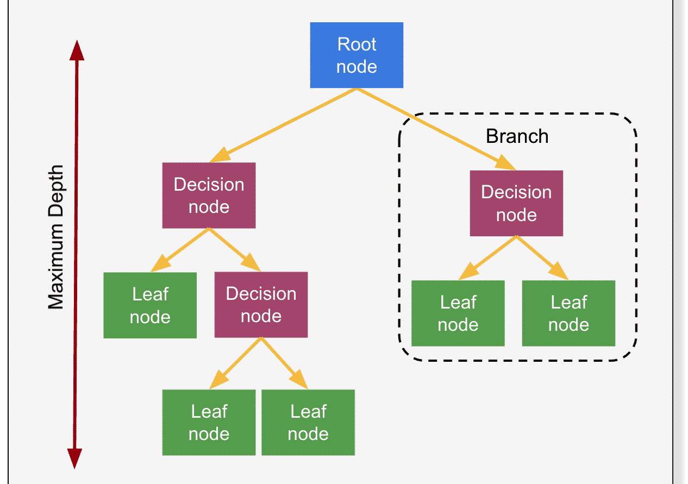
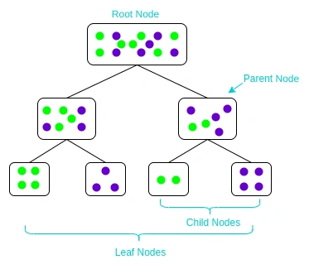
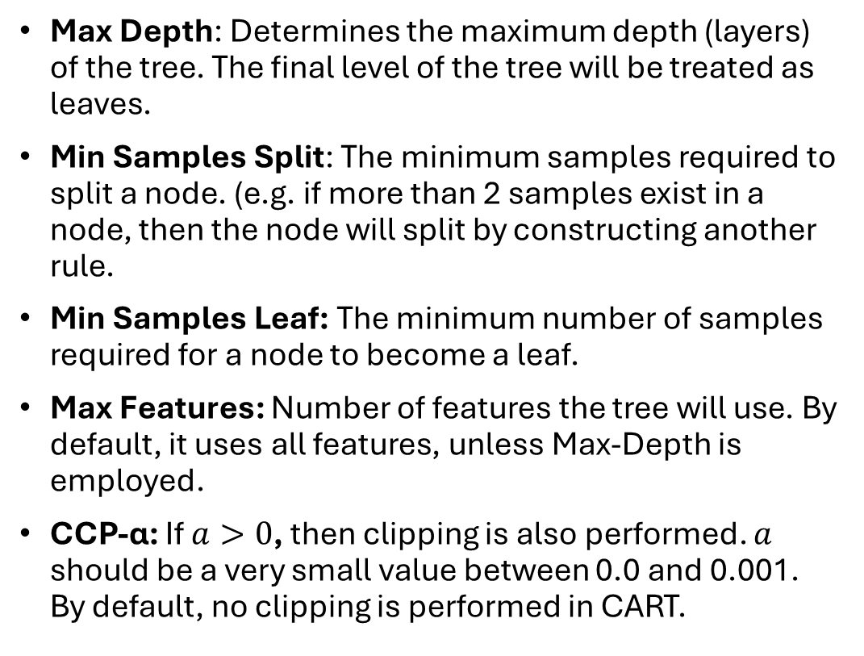
Decision Tree Parameters
Max Depth: Determines the maximum depth (layers) of the tree. The final level of the tree will be treated as leaves.
Min Samples Split: The minimum samples required to split a node. (e.g. if more than 2 samples exist in a node, then the node will split by constructing another rule.
Min Samples Leaf: The minimum number of samples required for a node to become a leaf.
Max Features: Number of features the tree will use. By default, it uses all features, unless Max-Depth is employed.
CCP-α: If $a>0$, then clipping is also performed. $a$ should be a very small value between 0.0 and 0.001. By default, no clipping is performed in CART.
Min Samples Split = 6

Slide 12
Decision Tree Disadvantages
Prone to overfitting (Performs well in the training set, but achieves low performance in the test set).
Unstable to noisy data (e.g. Outliers).
Unstable to datasets with unbalanced classes (Tend to estimate well only classes with high frequency and perform worse in classes with small frequency).
Low performance in regression tasks.

Slide 13
Ensemble
Idea: Training a model in a large dataset can be difficult (see Disadvantages of DT).
Ensemble methods combine multiple weak predictors in subsets of the original dataset to make more accurate decisions.
Example: A single decision tree is weak, but if we combine the predictions of multiple decision trees, we construct a stronger model.
Advantages:
  Reduce overfitting.
  Increase generalization ability.
  Robust to noise and outliers.
Disadvantages:
  Increases time complexity.
  The combined model is no longer interpretable.
  The ideal number of weak estimators is unknown and must be found manually.

Slide 14
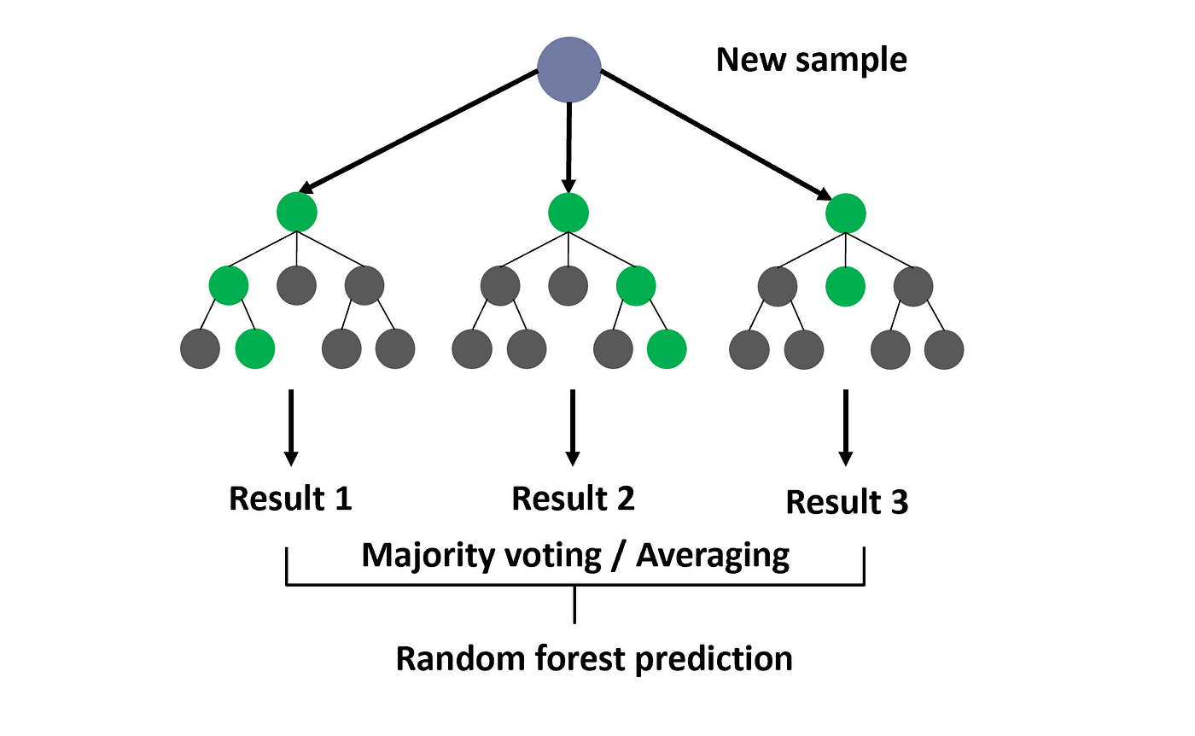
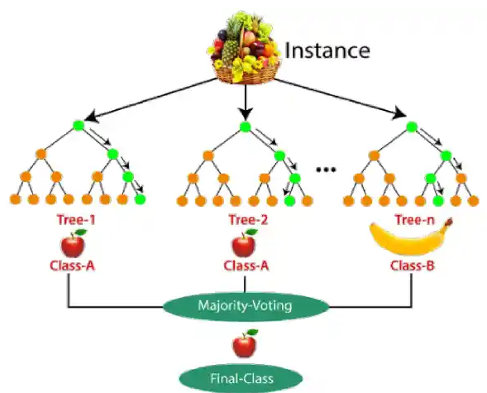
Random Forest Algorithm
Construct multiple decision trees (Estimators).
  Requires the user to enter the number of estimators (number of decision trees)>
Each decision tree uses only a subset of features.
Voting Technique: Computes the average decision from all trees (for regression) or the majority of votes (for classification).

Slide 15
Machine Learning
Decision Trees & Random Forests Notes

